Slide 1
Missing Value Treatment

Slide 2
Deletion Methods
Delete all cases with incomplete data and conduct analysis using only complete cases.
Advantage: Simplicity
Disadvantage: loss of data if we discard all incomplete cases. So, in efficient
NOTE: If you use complete case analysis, then change summary statistics for other variables, too.

Slide 3
Example: n=19,p=4, only 15% missing values
Individual | Case 1 |  |  |  | Case 2 |  |  |  | Case 3
 | y₁ | y₂ | y₃ | y₄ | y₁ | y₂ | y₃ | y₄ | y₁ | y₂ | y₃ | y₄
1 | NA | NA | NA | NA | NA |  |  |  | NA
2 | NA | NA |  |  | NA |  |  |  | NA
3 |  |  |  |  | NA |  |  |  |  | NA
4 |  |  |  |  | NA |  |  |  |  | NA
5 |  |  |  |  | NA |  |  |  |  |  | NA
6 |  |  |  |  | NA |  |  |  |  |  | NA
7
8
9
10
Eliminate individual 1 and 2.
Keep 8*4=32 data. 20% loss
Eliminate variable 1.
Keep 10*3=30 data. 25% loss
Eliminate individual 1 -6.
Keep 4*4=16 data. 60% loss

Slide 4
Listwise Deletion (Complete case analysis)
Only analyze cases with available data on each variable
Advantage: simplicity and comparability across analyses
Disadvantage: reduces statistical power (due to sample size), not use all information, estimates may be biased if data not MCAR
Listwise deletion often produces unbiased regression slope estimates as long as missingness is not a function of outcome variable.

Slide 5
Pairwise Deletion (Available case analysis)
Analysis with all cases in which the variables of interest are present
Advantage: keeps as many cases as possible for each analysis, uses all information possible with each analysis
Disadvantage: cannot compare analyses because sample is different each time, sample size vary for each parameter estimation, can obtain nonsense results
Compute the summary statistics using n_{i} observations not n.
Compute correlation type statistics using complete pairs for both variables.

Slide 6
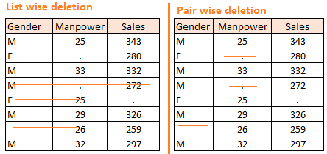
Example

Slide 7
Imputation Methods
Mean/Median/Mode Substitution
Replace missing value with the sample mean or mode. Then, run analyses as if all complete cases
Advantage: We can use complete case analyses
Disadvantage: Reduces variability, weakens the correlation estimates because it ignores the relationship between variables, it creates artificial band
Unless the proportion of missing data is low, do not use this method.

Slide 8
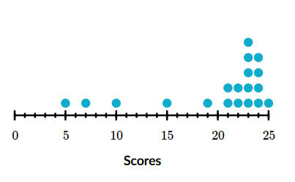
Outlier Treatment

Slide 9
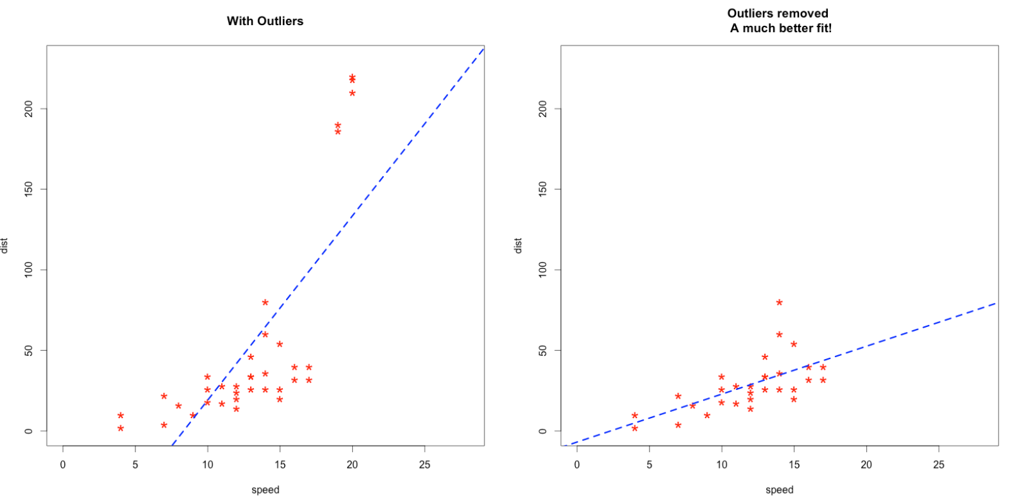

Slide 10
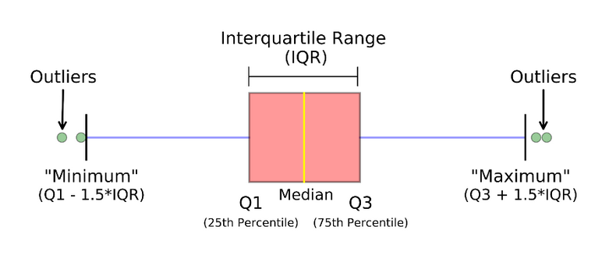
Box-Plot Rule

Slide 11
Deleting observations:
if it is due to data entry error or data processing error
outlier observations are very small in numbers.

